Slide 1
Text Mining
MSc Artificial Intelligence and Data Engineering
Data Mining and Machine Learning
Design and implement a framework in python
Presented by Alberto CARUSO, Pietro CALABRESE

Slide 2
Text Mining
Is the process of deriving high-quality information from text.
The overarching goal is, essentially, to turn text into data for analysis, via application of natural language processing (NLP), different types of algorithms and analytical methods.
An important phase of this process is the interpretation of the gathered info.
A typical application is to scan a set of documents written in a natural language and either model the document set for predictive classification purposes.
A. Caruso, P. Calabrese

Slide 3
Text Representation and Classification Process
Pre-Processing
Text Representaion
B O W
Text classification Model
SVM
Normalization
Tokenization
Stopwords Filtering
Stemming
Word Embedding
CNB
PAC
MLP
CNN
LSTM
A. Caruso, P. Calabrese

Slide 4
Project Goal
Experiment some supervised machine learning models for automatic text classification.
We want develop a framework that identify the most effective text classification model to embed into an external service.
All this is carried out comparing 6 different models
We focused our attention on the categorization of political documents.
A. Caruso, P. Calabrese

Slide 5

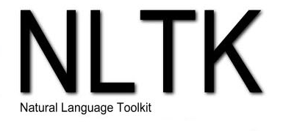


Experimental Setup
Load Dataset
We carried out a 10-fold stratified cross-validation
We repeted the cross-validation 5 times
In order to evaluate the performance we extracted also matrics per each class
Pre - Processing
Model
Metrics Selection
A. Caruso, P. Calabrese

Slide 6
Dataset used in the Project
Italian Parliament QT
Indian parliament Q&A
Language : Italian
Number of Classes: 21
Max num. of Features : 8432
Number of setences : 5672
Language : English
Number of Classes: 69
Max num. of Features : 10534
Number of setences : 89093
A. Caruso, P. Calabrese

Slide 7
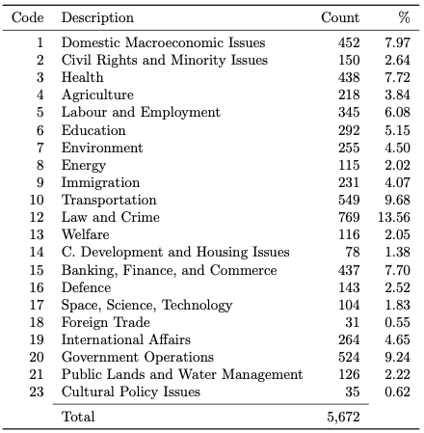
Italian Parliament QT Dataset
A. Caruso, P. Calabrese

Slide 8
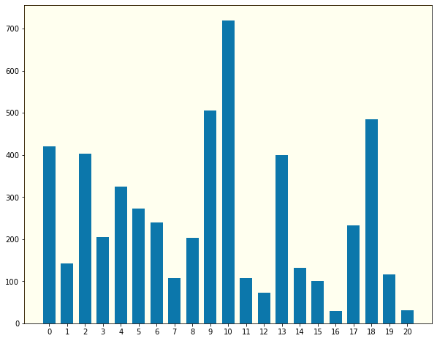
Italian Parliament QT Dataset
Counts
Class Distribution Diagram
Classes
A. Caruso, P. Calabrese

Slide 9
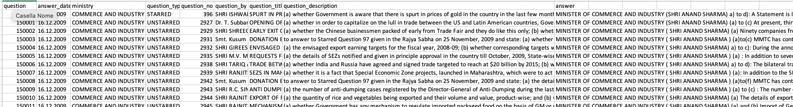
Indian Parliament Q&A Dataset Dataset
HOME AFFAIRS’,
'FINANCE’,
'HEALTH AND FAMILY WELFARE’,
'RAILWAYS’,
'HUMAN RESOURCE DEVELOPMENT’,
'AGRICULTURE AND FARMERS WELFARE’,
'ENVIRONMENT, FOREST AND CLIMATE CHANGE’,
'PETROLEUM AND NATURAL GAS’,
'CIVIL AVIATION’,
'CONSUMER AFFAIRS,
FOOD AND PUBLIC DISTRIBUTION’,
HOME AFFAIRS’,
'FINANCE’,
'HEALTH AND FAMILY WELFARE’,
'RAILWAYS’,
'HUMAN RESOURCE DEVELOPMENT’,
'AGRICULTURE AND FARMERS WELFARE’,
'ENVIRONMENT, FOREST AND CLIMATE CHANGE’,
'PETROLEUM AND NATURAL GAS’,
'CIVIL AVIATION’,
'CONSUMER AFFAIRS,
FOOD AND PUBLIC DISTRIBUTION’,
'COMMUNICATION, ELECTRONICS AND INFORMATION TECHNOLOGY’,
'LABOUR AND EMPLOYMENT’,
'DEFENCE’,
'EXTERNAL AFFAIRS’,
'POWER’,
A. Caruso, P. Calabrese

Slide 10
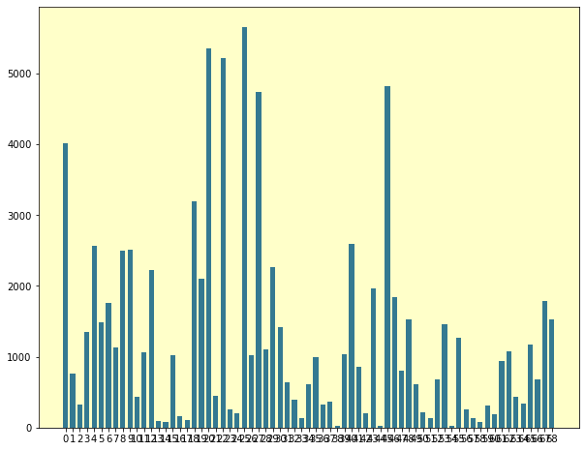
Indian Parliament Q&A Dataset
Counts
Class Distribution Diagram
Classes
A. Caruso, P. Calabrese

Slide 11
Bag Of Word - Text Representation
classical machine learning classification algorithms
A. Caruso, P. Calabrese

Slide 12
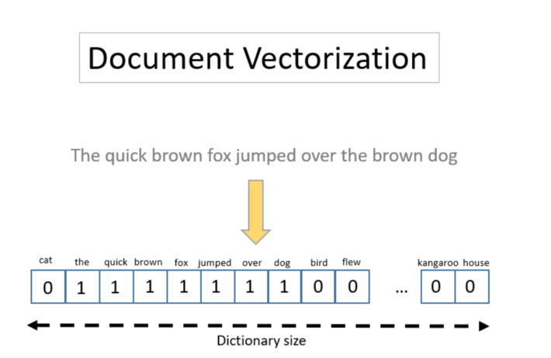
Bag Of Word - Text Representation
Every pre-processed text is represented as a sparse vector in $ℝ^{\left|V\right|}$, where V is a term vocabulary
Given a pre-processed text $δ_{i}$, the entries in its BOW representation $x_{i}∈ ℝ^{\left|V\right|}$ corresponding to terms not appearing in the text are set to 0.
A. Caruso, P. Calabrese

Slide 13
Bag Of Word - Text Representation
We can compute the entries corrisponding to appearing in the document using some projection method:
Term count
Term frequency
Term frequency-inverse document frequency
The dimension $\left|V\right|$ of the feature space to represent documents can be very large
Each term is treated independently from the other terms, losing any relationships
A. Caruso, P. Calabrese

Slide 14
Bag Of Word – Feature Selection
In order to reduce the size of the feature space, several feature selection strategies can be used
Features Selected
The feature selection strategy adopted exploits the Information Gain
Features Space
$$IG\left(Class, Attribute\right)=H\left[Class\right]−H_{A_{i}}[Class]$$
We experimented different Max Number of Features, spanning from 2000 to 7000
A. Caruso, P. Calabrese

Slide 15
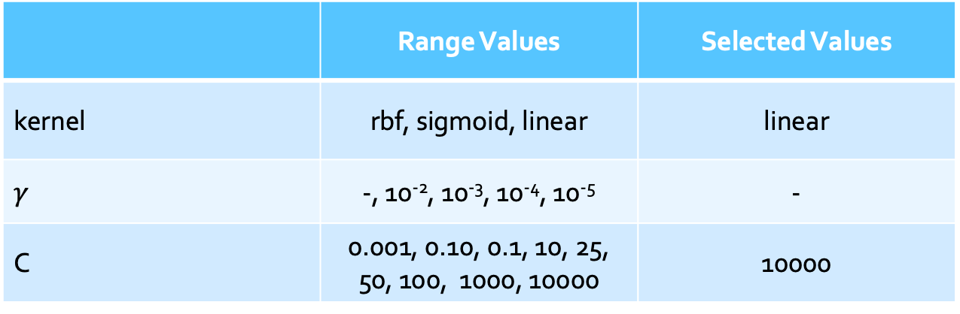
BOW : Support Vector Machine Approch
A support vector machine constructs a set of separating hyper-planes in the inputs' vector space, which can be used for classification among other tasks
 | Range Values | Selected Values
kernel | rbf, sigmoid, linear | linear
$$γ$$ | -, 10⁻², 10⁻³, 10⁻⁴, 10⁻⁵ | -
C | 0.001, 0.10, 0.1, 10, 25, 50, 100, 1000, 10000 | 10000
A. Caruso, P. Calabrese

Slide 16
BOW : Support Vector Machine - Results
Italian Parliament QT Dataset
A. Caruso, P. Calabrese

Slide 17
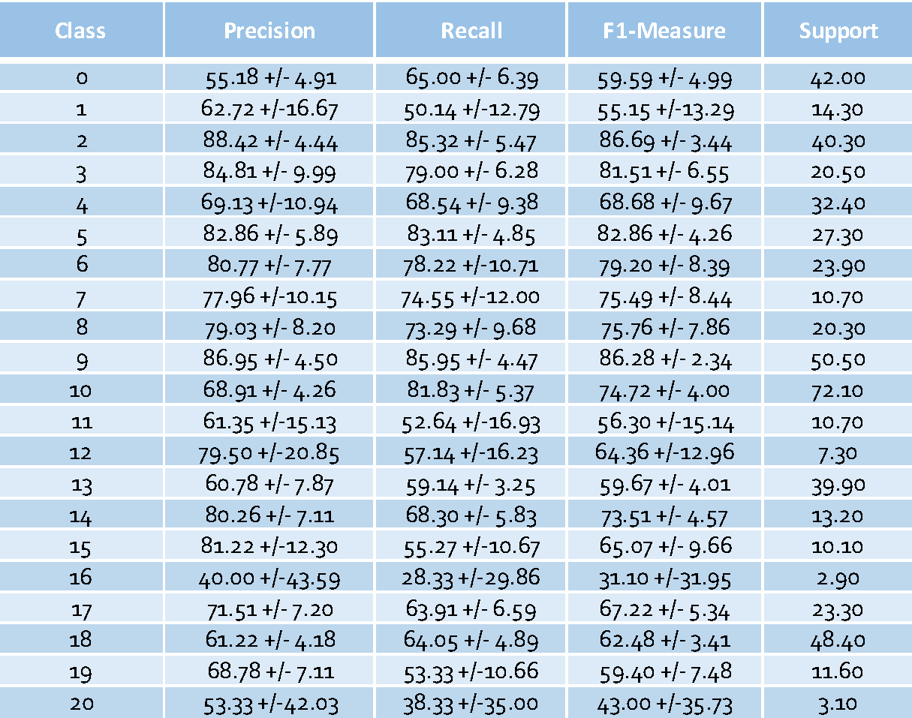
BOW : Support Vector Machine Approch
Overall results
Overall results – classes analisys
Italian Parliament QT Dataset
A. Caruso, P. Calabrese

Slide 18
BOW : Support Vector Machine - Results
Indian Parliament Q&A Dataset
A. Caruso, P. Calabrese

Slide 19
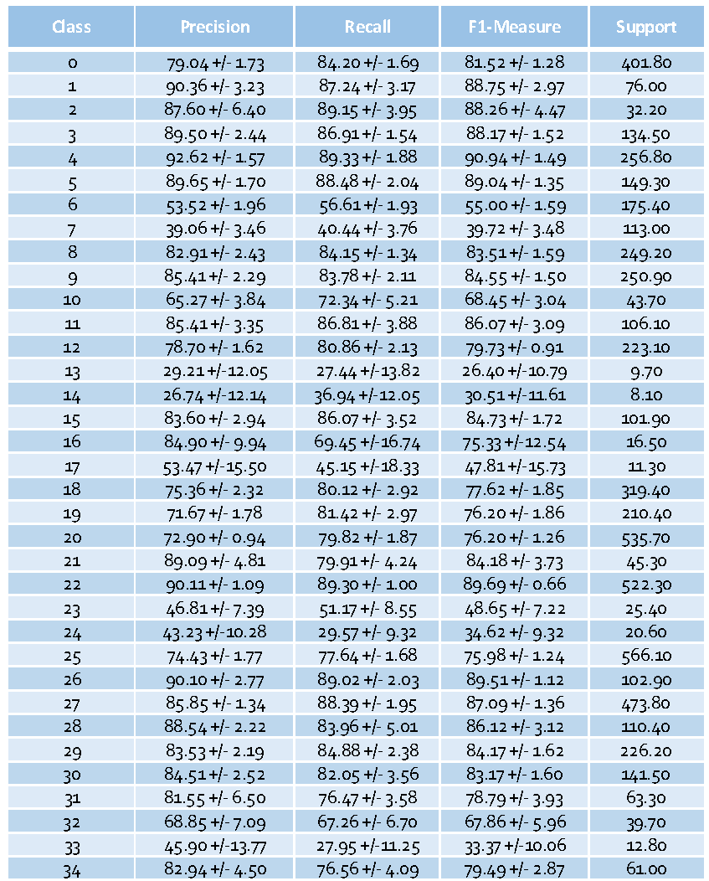
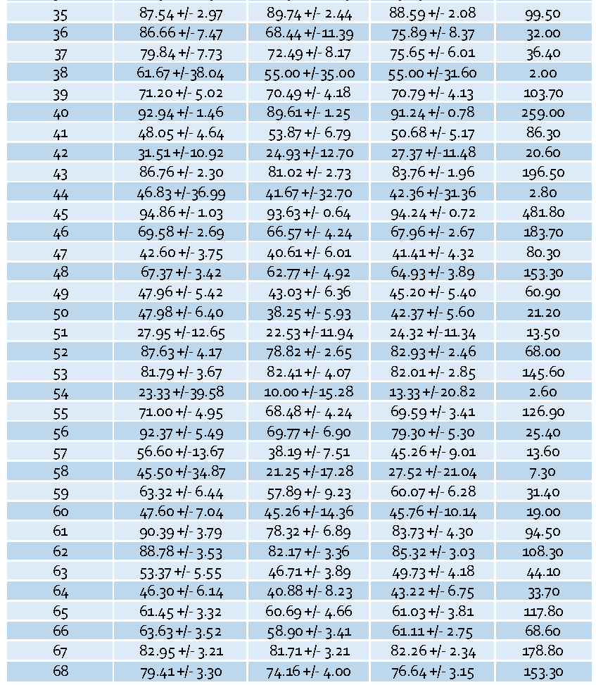
BOW : Support Vector Machine Approch
Overall results
Overall results – classes analisys
Indian Parliament Q&A Dataset
A. Caruso, P. Calabrese

Slide 20
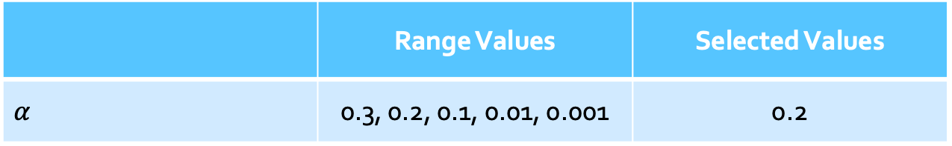
BOW : Complement Naïve Bayes Approch
It is a modified version of the multinomial naïve bayes classifier for texts, addressing word dependencies assumption and unbalanced classes
 | Range Values | Selected Values
$$α$$ | 0.3, 0.2, 0.1, 0.01, 0.001 | 0.2
A. Caruso, P. Calabrese

Slide 21
BOW : Complement Naïve Bayes - Results
Italian Parliament QT Dataset
A. Caruso, P. Calabrese

Slide 22
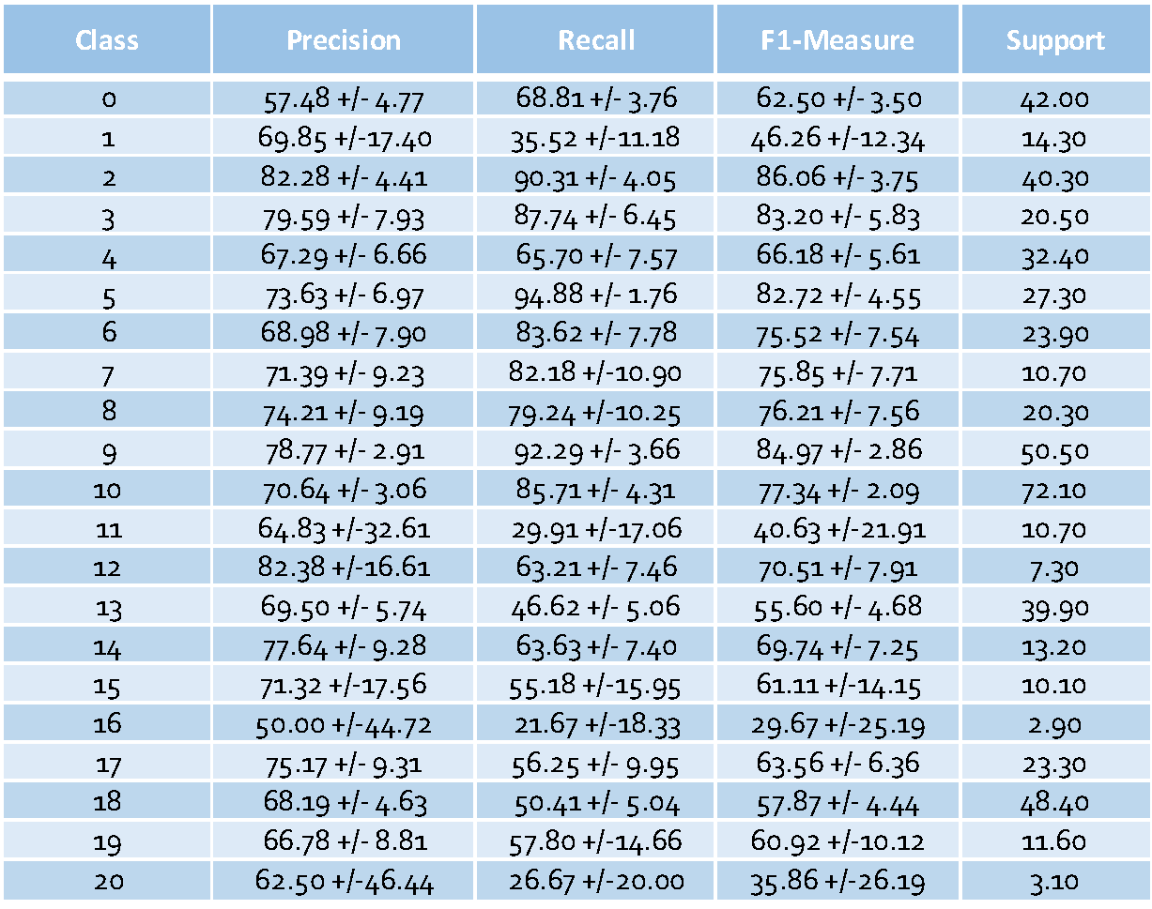
BOW : Complement Naïve Bayes Approch
Overall results
Overall results – classes analisys
Italian Parliament QT Dataset
A. Caruso, P. Calabrese

Slide 23
BOW : Complement Naïve Bayes - Results
Indian Parliament Q&A Dataset
A. Caruso, P. Calabrese

Slide 24
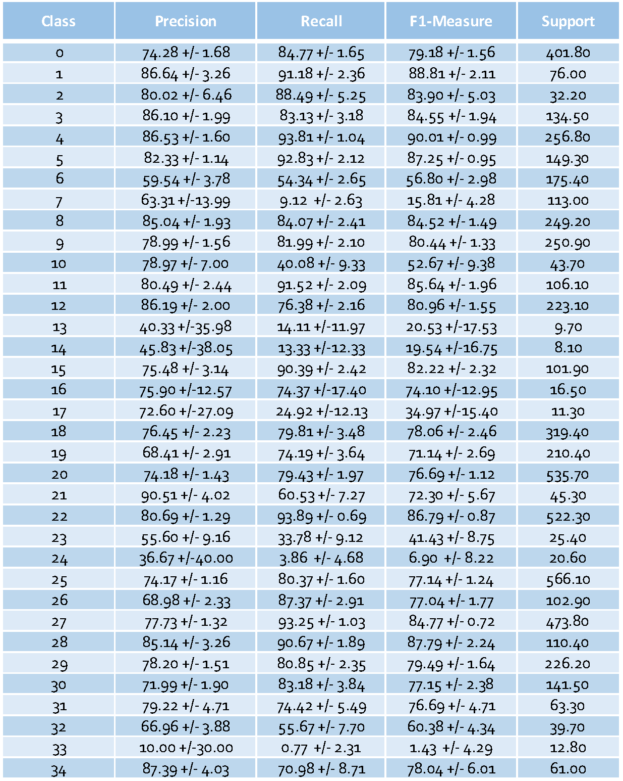
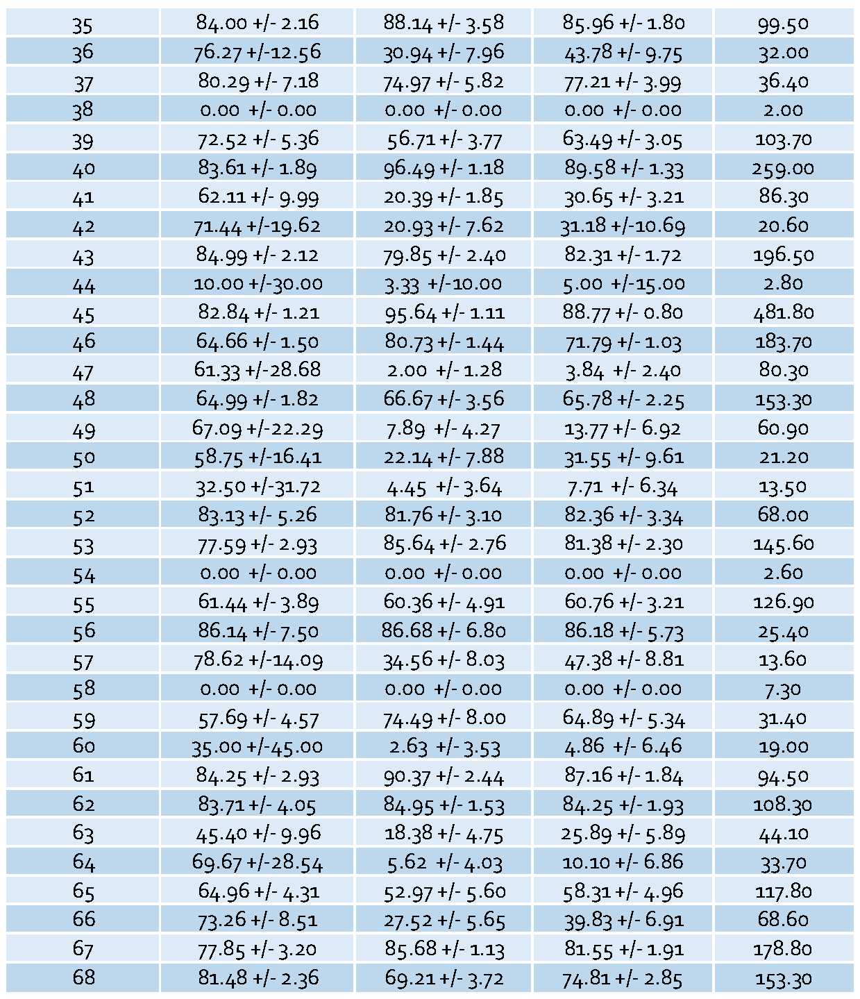
BOW : Complement Naïve Bayes Approch
Overall results
Overall results – classes analisys
Indian Parliament Q&A Dataset
A. Caruso, P. Calabrese

Slide 25
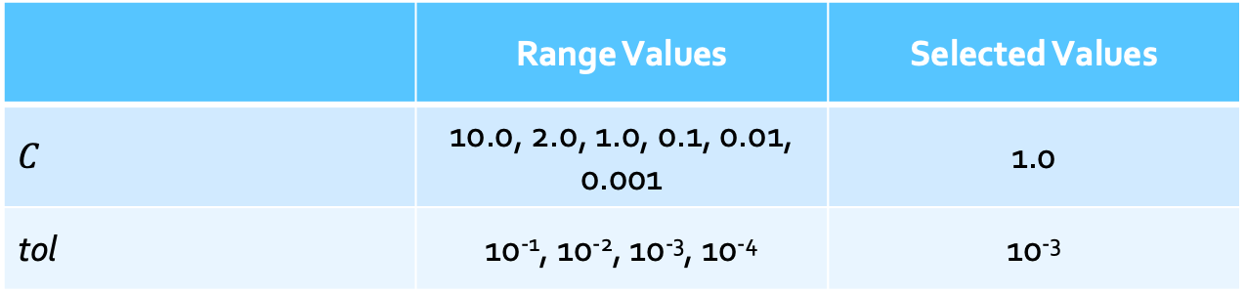
BOW : Passive Aggressive Classifier Approch
An online machine learning algorithm building a set of separating hyper-planes in the inputs’ vector space based on a single input at a time
 | Range Values | Selected Values
$$C$$ | 10.0, 2.0, 1.0, 0.1, 0.01, 0.001 | 1.0
tol | 10⁻¹, 10⁻², 10⁻³, 10⁻⁴ | 10⁻³
A. Caruso, P. Calabrese

Slide 26
BOW : Passive Aggressive Classifier - Results
Italian Parliament QT Dataset
A. Caruso, P. Calabrese

Slide 27
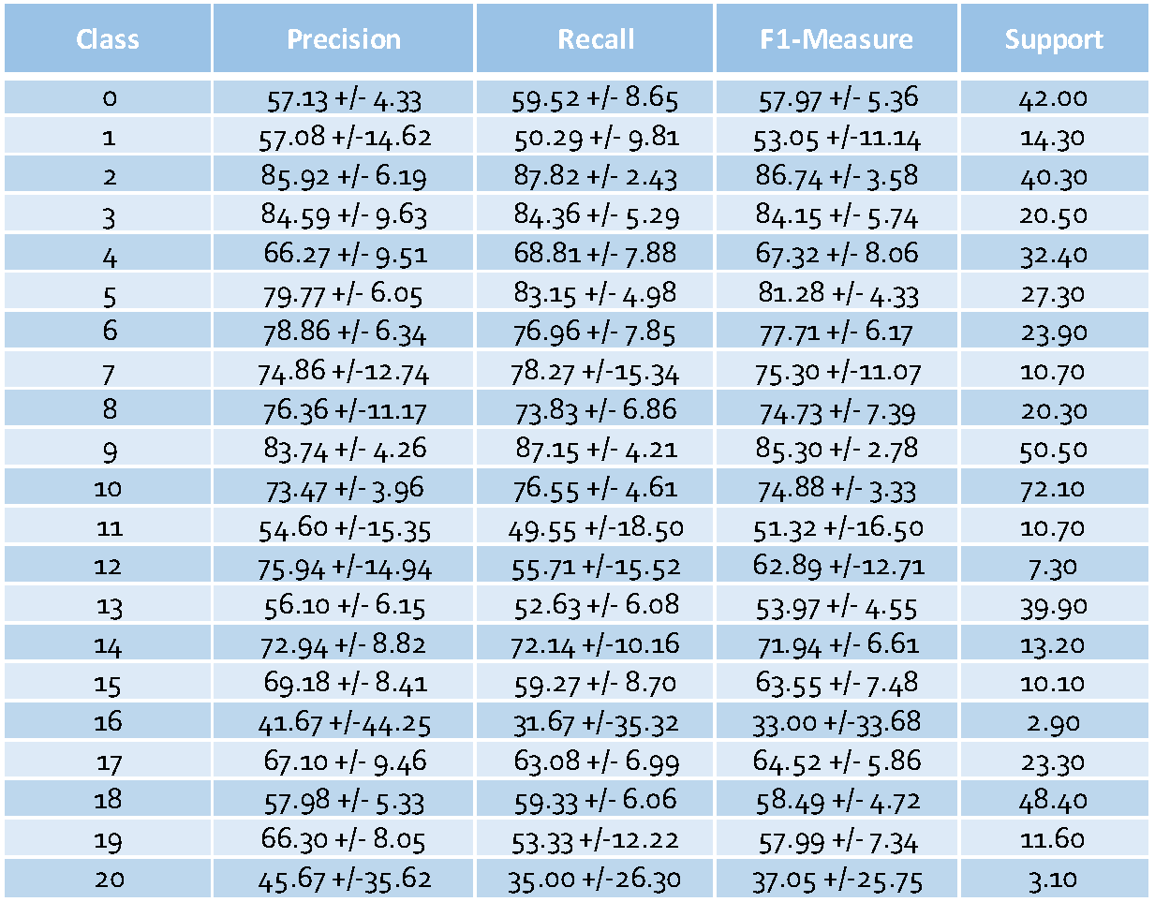
BOW : Passive Aggressive Classifier Approch
Overall results
Overall results – classes analisys
Italian Parliament QT Dataset
A. Caruso, P. Calabrese

Slide 28
BOW : Passive Aggressive Classifier - Results
Indian Parliament Q&A Dataset
A. Caruso, P. Calabrese

Slide 29
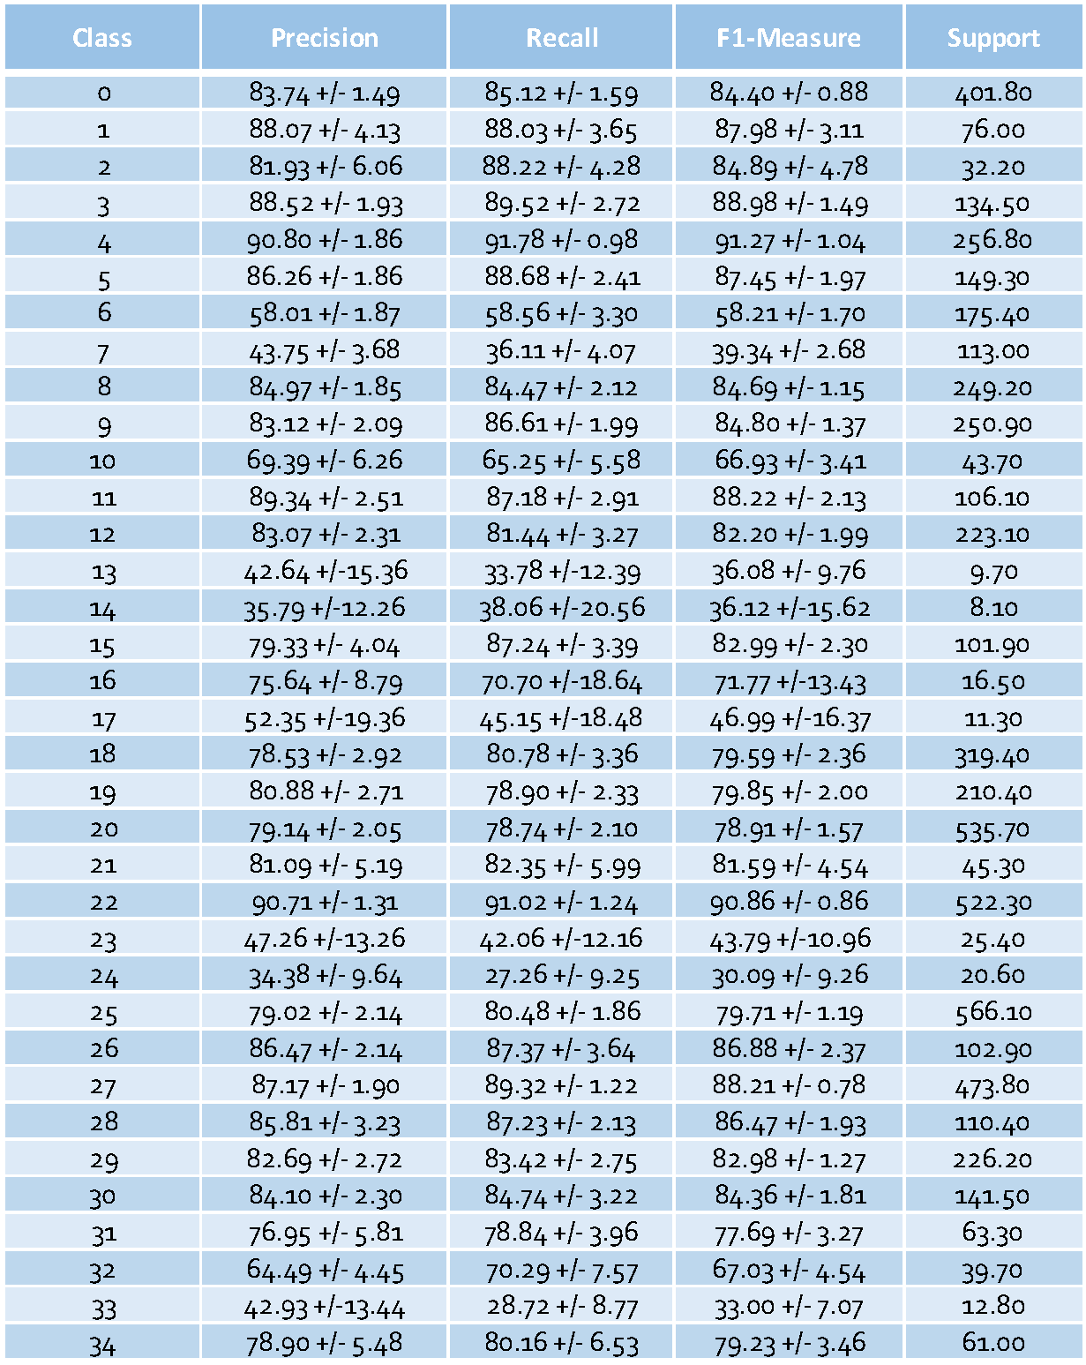
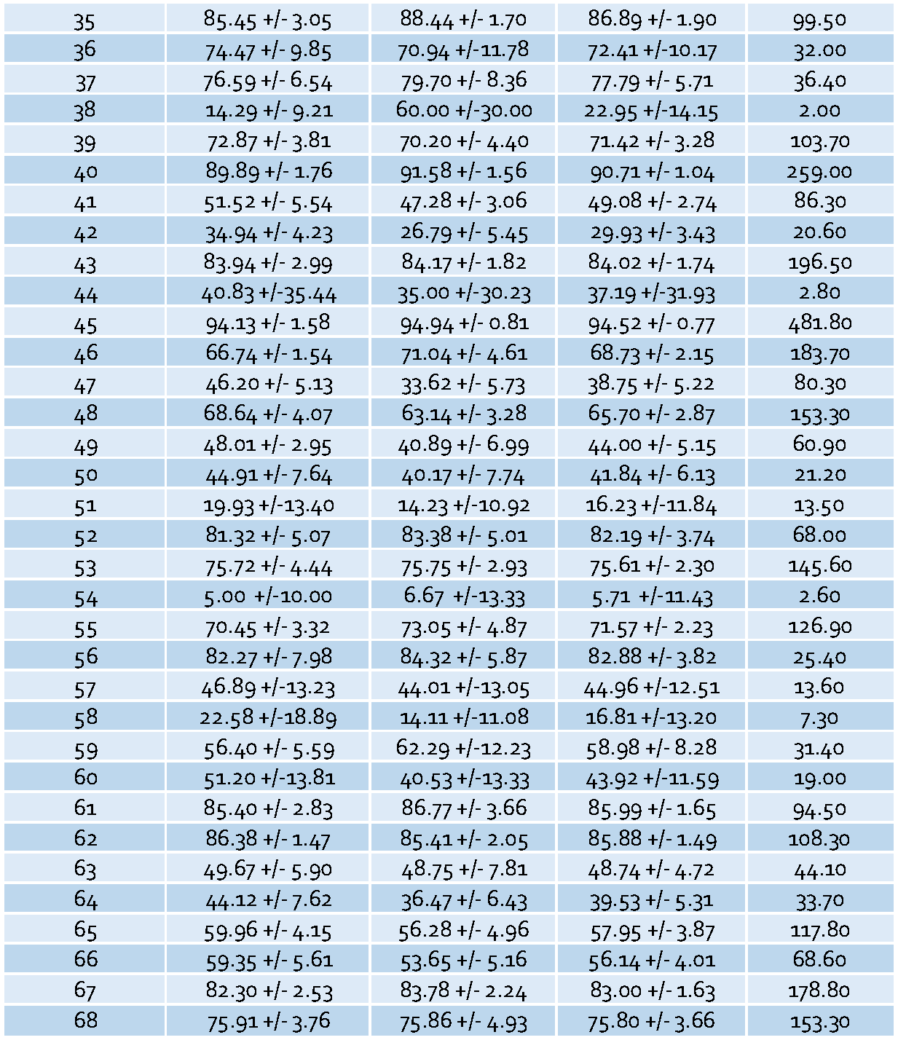
BOW : Passive Aggressive Classifier Approch
Overall results
Overall results – classes analisys
Indian Parliament Q&A Dataset
A. Caruso, P. Calabrese

Slide 30
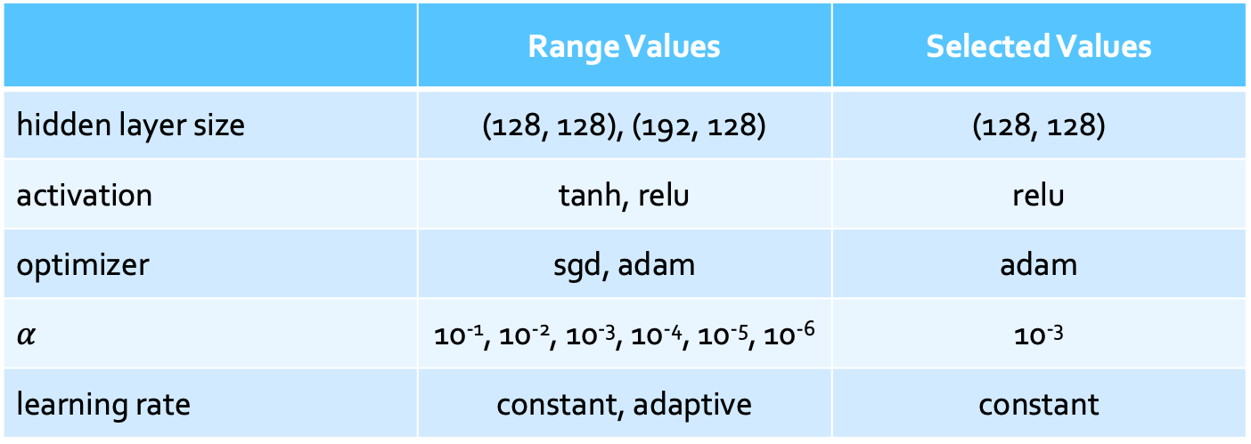
BOW : Multi-Layer Percepton Approch
An artificial neural network with a single hidden layer that learns a non-linear function approximator for classification
 | Range Values | Selected Values
hidden layer size | (128, 128), (192, 128) | (128, 128)
activation | tanh, relu | relu
optimizer | sgd, adam | adam
$$α$$ | 10⁻¹, 10⁻², 10⁻³, 10⁻⁴, 10⁻⁵, 10⁻⁶ | 10⁻³
learning rate | constant, adaptive | constant
A. Caruso, P. Calabrese

Slide 31
BOW : Multi-Layer Percepton - Results
Italian Parliament QT Dataset
A. Caruso, P. Calabrese

Slide 32
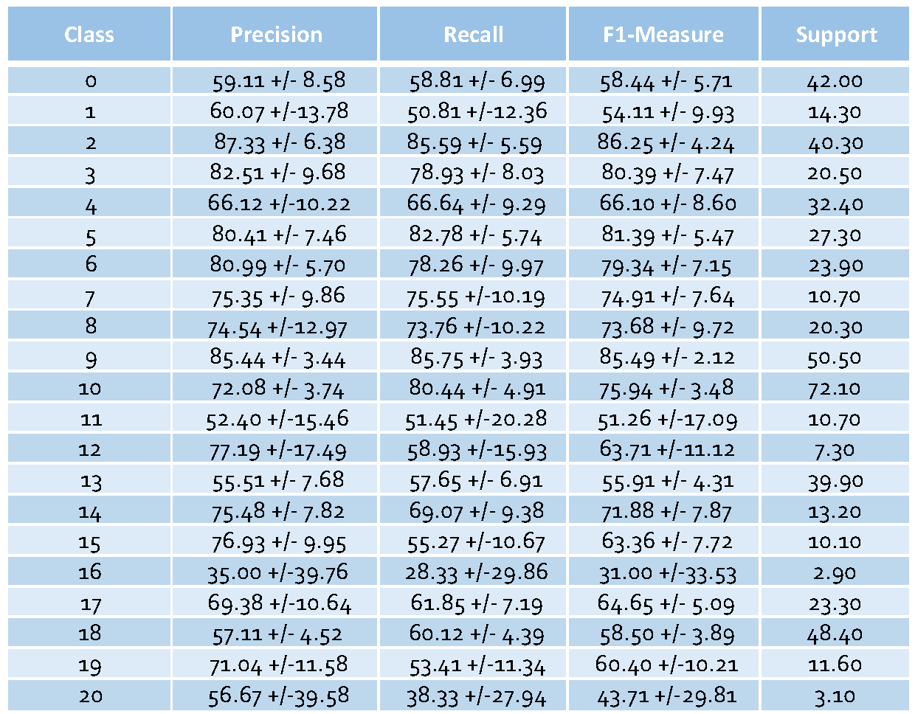
BOW : Multi-Layer Percepton Approch
Overall results
Overall results – classes analisys
Italian Parliament QT Dataset
A. Caruso, P. Calabrese

Slide 33
BOW : Multi-Layer Percepton - Results
Indian Parliament Q&A Dataset
A. Caruso, P. Calabrese

Slide 34
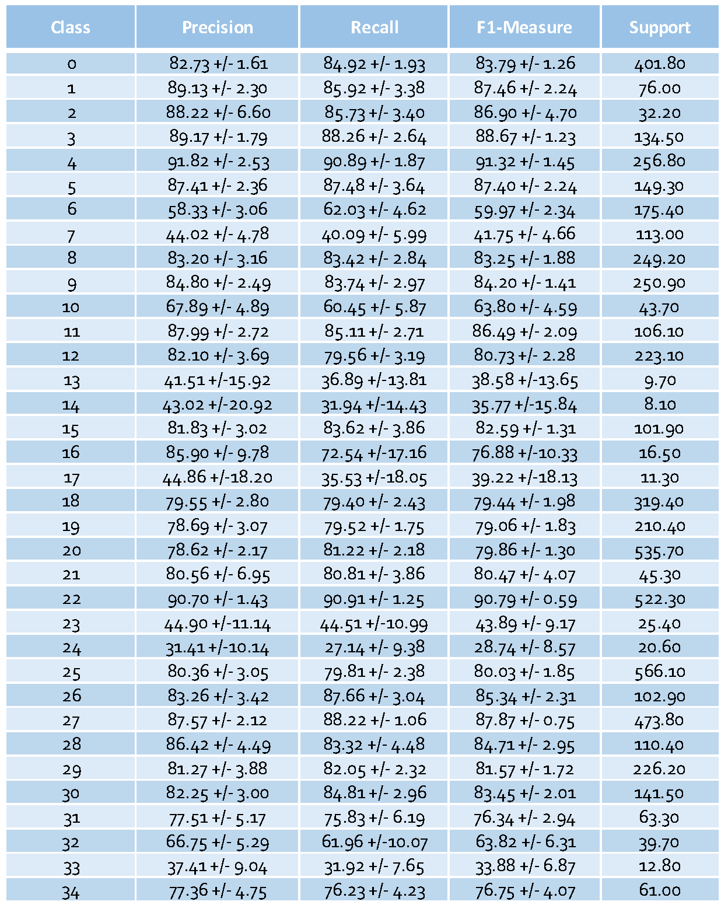
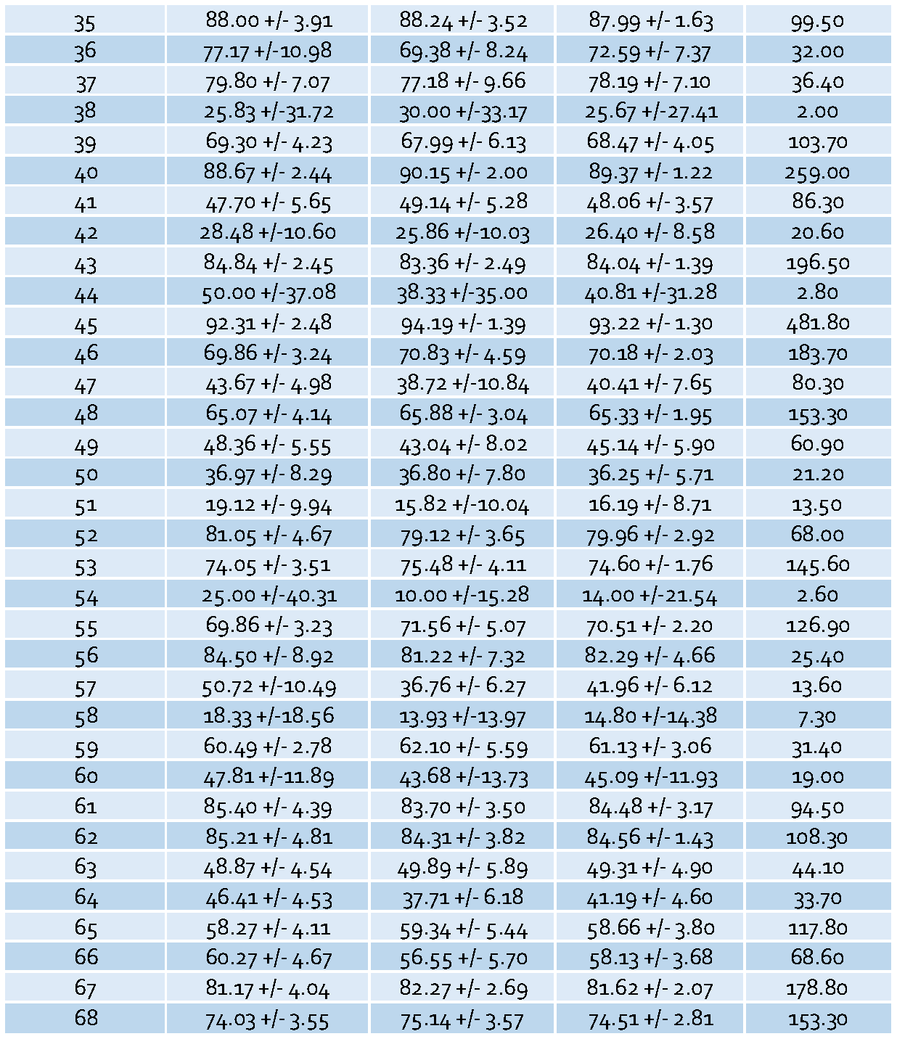
BOW : Multi-Layer Percepton Approch
Overall results
Overall results – classes analisys
Indian Parliament Q&A Dataset
A. Caruso, P. Calabrese

Slide 35
Overall Result of ML Algoriths with Different Number of Feature
Italian Parliament QT Dataset
SVM
CNB
PAC
MLP
A. Caruso, P. Calabrese

Slide 36
Word Embeddings - Text Representation
deep learning models
A. Caruso, P. Calabrese

Slide 37
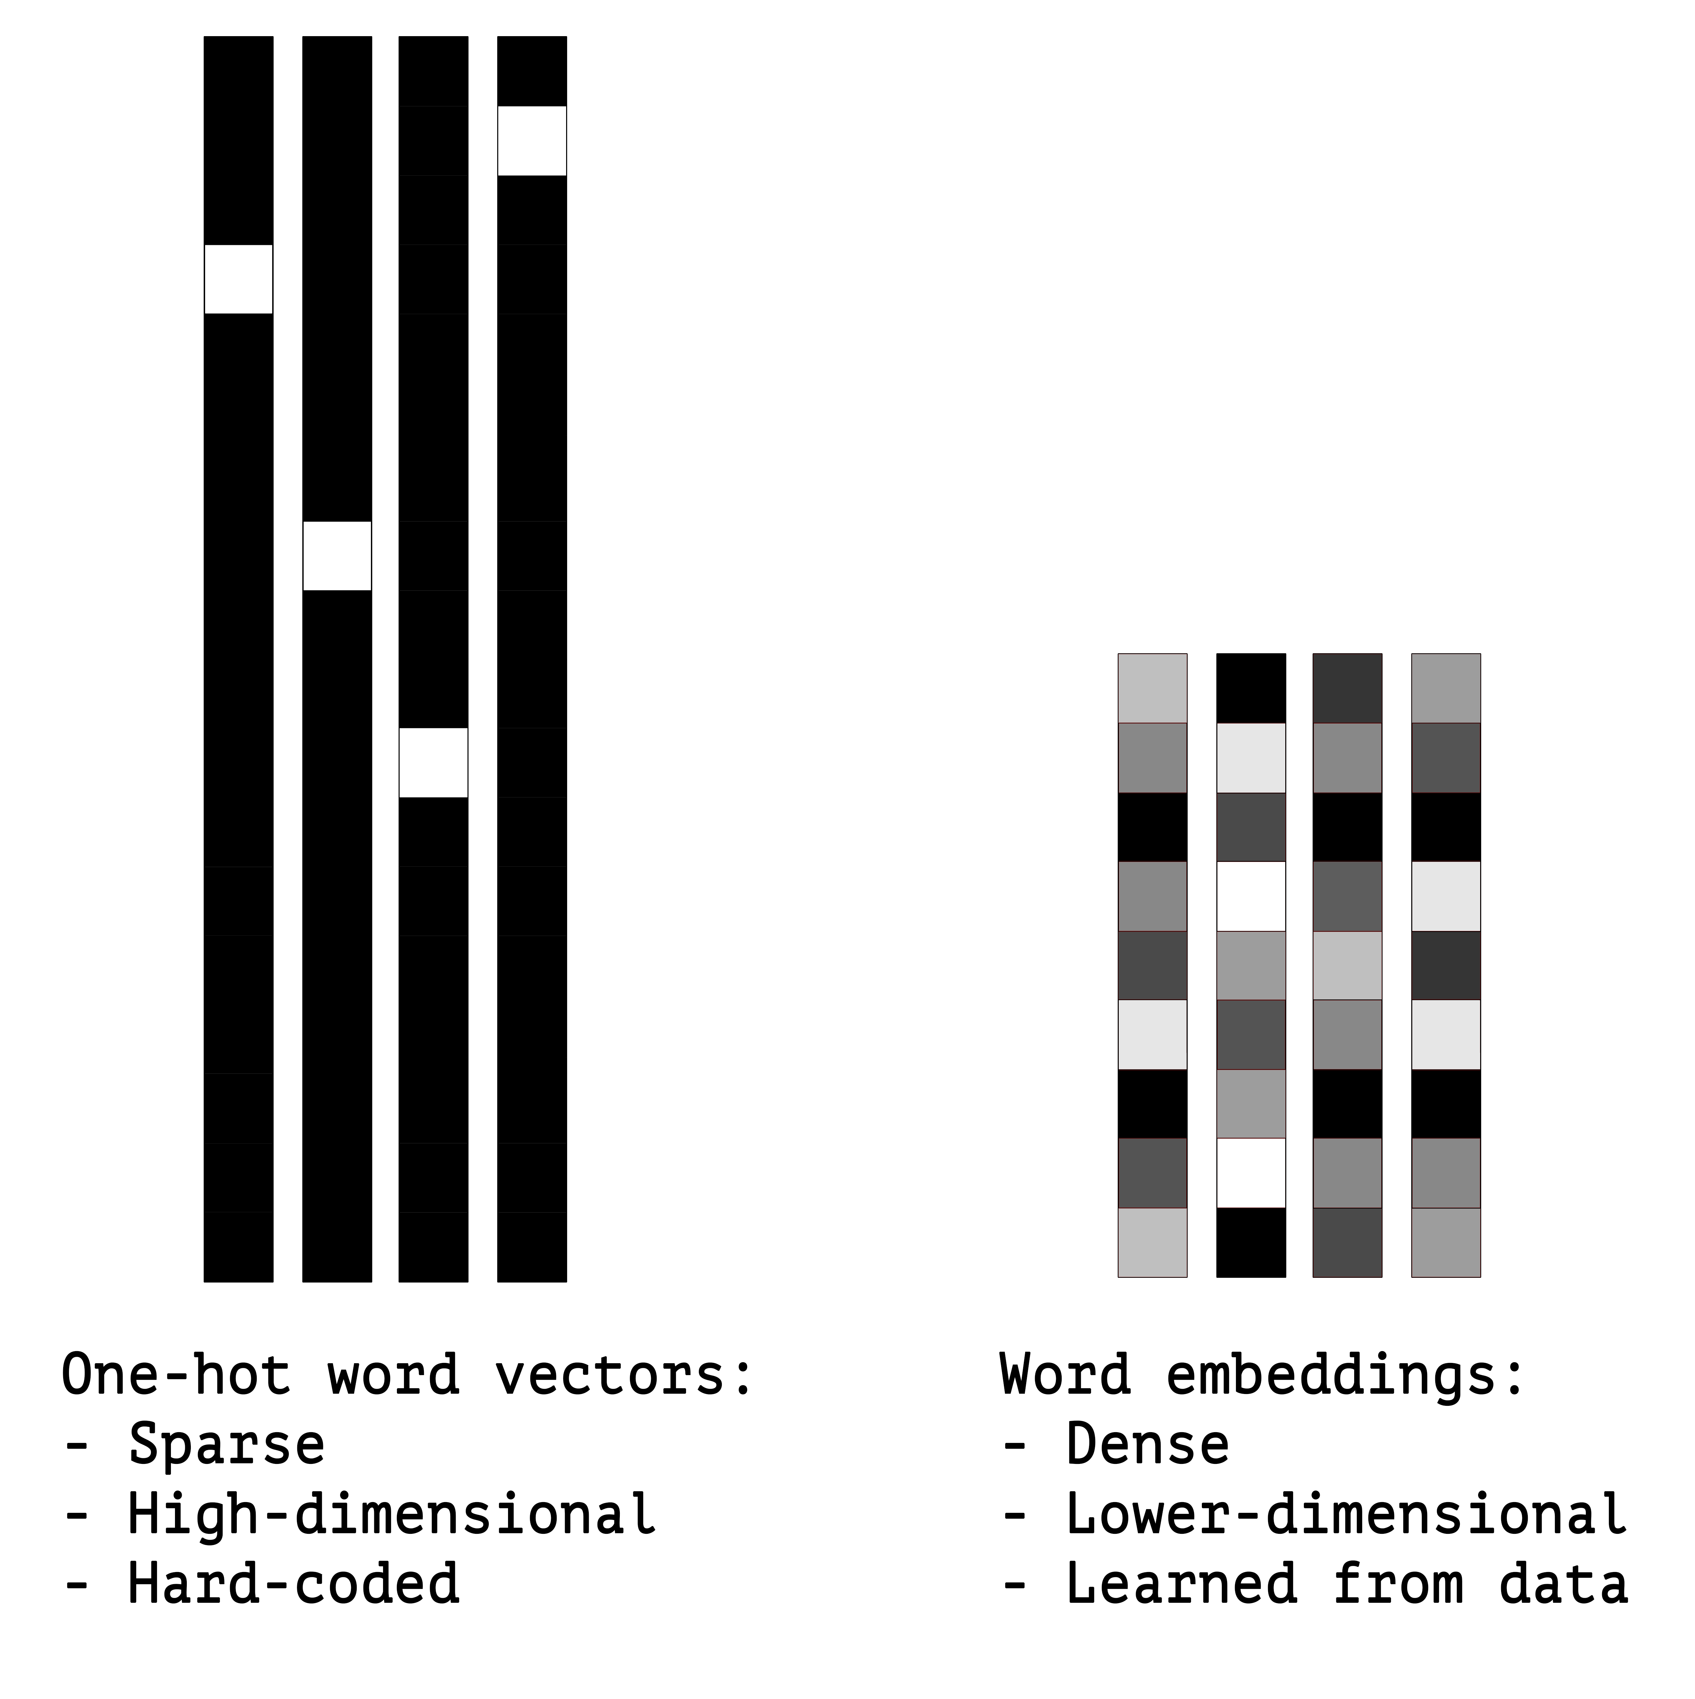
Word Embeddings - Text Representation
Every pre-processed text is represented in an $e$-dimensional vector space, with $e≪ \left|V\right|$
Each terms is represented in a $p$-dimensional vector space in such a way that semantically-related
terms are mapped into closer vectors . $p$ usually spans from 50 to 300
A. Caruso, P. Calabrese

Slide 38
Word Embeddings - Text Representation
The elements of the word embeddings vector space are learned through deep learning techniques
The most commonly used word embedding, pre-trained on the Wikipedia corpus and available to be used
directly for several languages, are:
Word2Vec
GloVe
FastText
A. Caruso, P. Calabrese

Slide 39
Word Embeddings - FastText
FastText is an open-source, free, lightweight library that allows users to learn text
representations and text classifiers
This library can be used to train supervised text classifiers, for instance for sentiment analysis,
in order to train a text classifier
The word embeddings are computed by considering n-grams at character level and surrounding n-grams
instead of single word and its surrouding words
A. Caruso, P. Calabrese

Slide 40
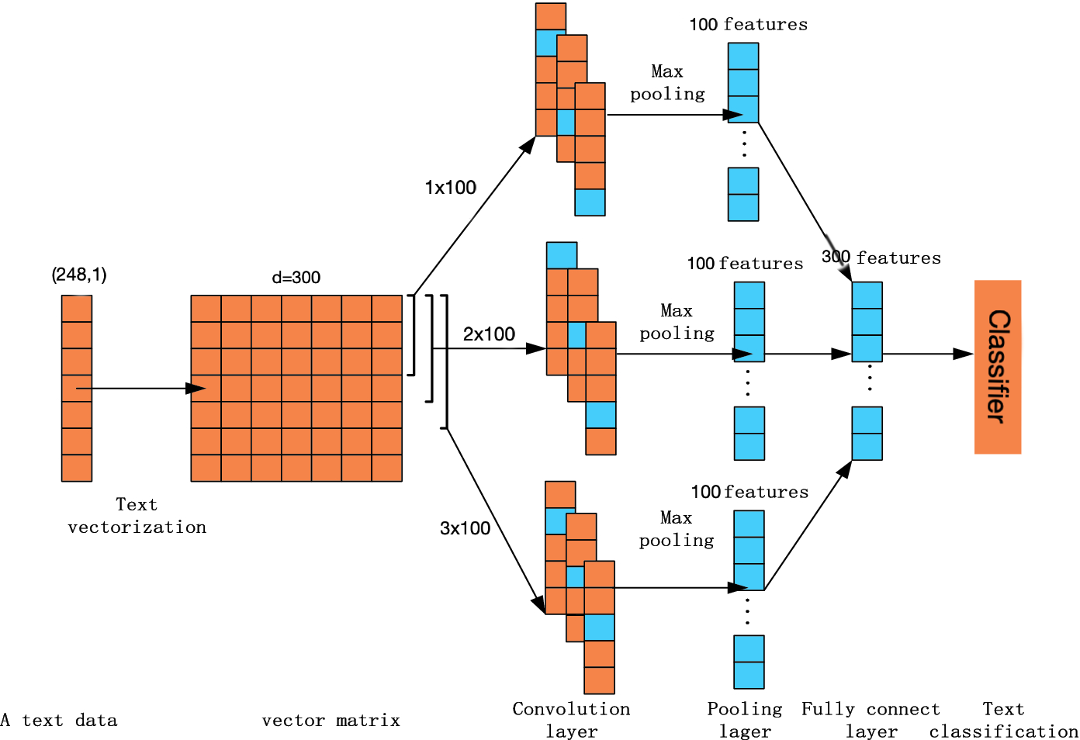
Word Embedding: Convolutional Neural Network Approch
An artificial neural network with multiple hidden layers, i.e., a deep neural network, where the layers exploit convolving filters that are applied to local features
248x300
A. Caruso, P. Calabrese

Slide 41
Word Embedding: Convolutional Neural Network Approch
Model Parameters
 | Range Values | Selected Values
Conv1D layer size | 64, 128, 192 | 128
Dense layer size | 64, 128, 192 | 128
activation | tanh, relu | relu
optimizer | sgd, adam | adam
A. Caruso, P. Calabrese

Slide 42
Word Embedding: Convolutional Neural Network - Results
Italian Parliament QT Dataset
A. Caruso, P. Calabrese

Slide 43
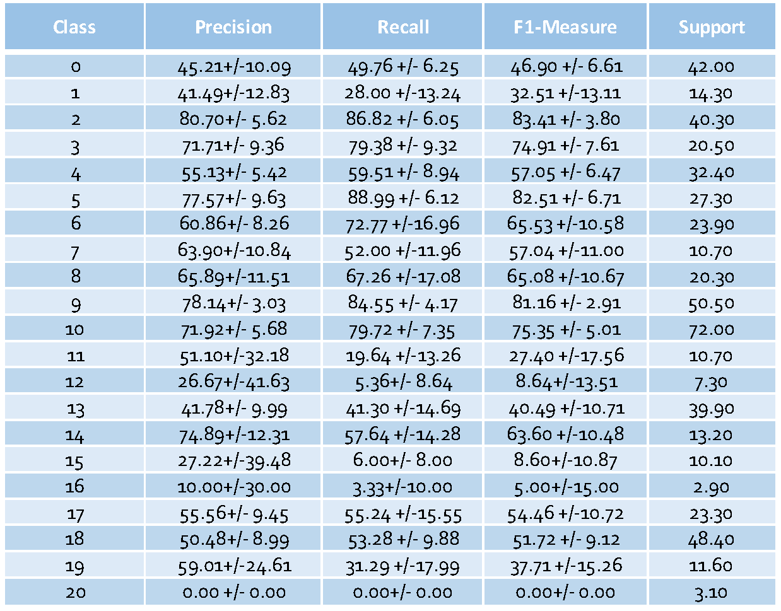
Word Embedding: Convolutional Neural Network Approch
Overall results
Overall results – classes analisys
Italian Parliament QT Dataset
A. Caruso, P. Calabrese

Slide 44
Word Embedding: Convolutional Neural Network - Results
Indian Parliament Q&A Dataset
A. Caruso, P. Calabrese

Slide 45
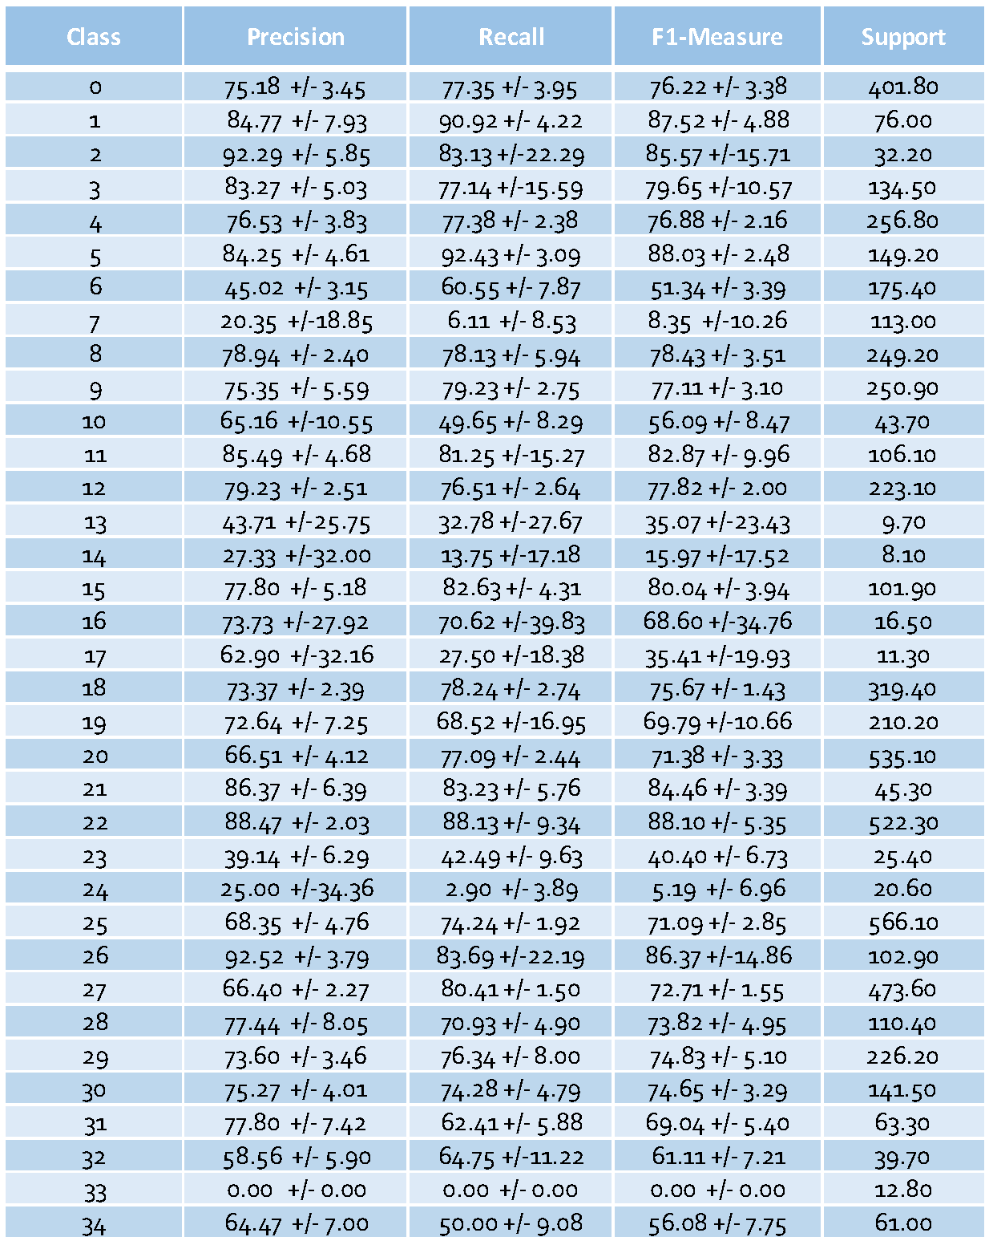
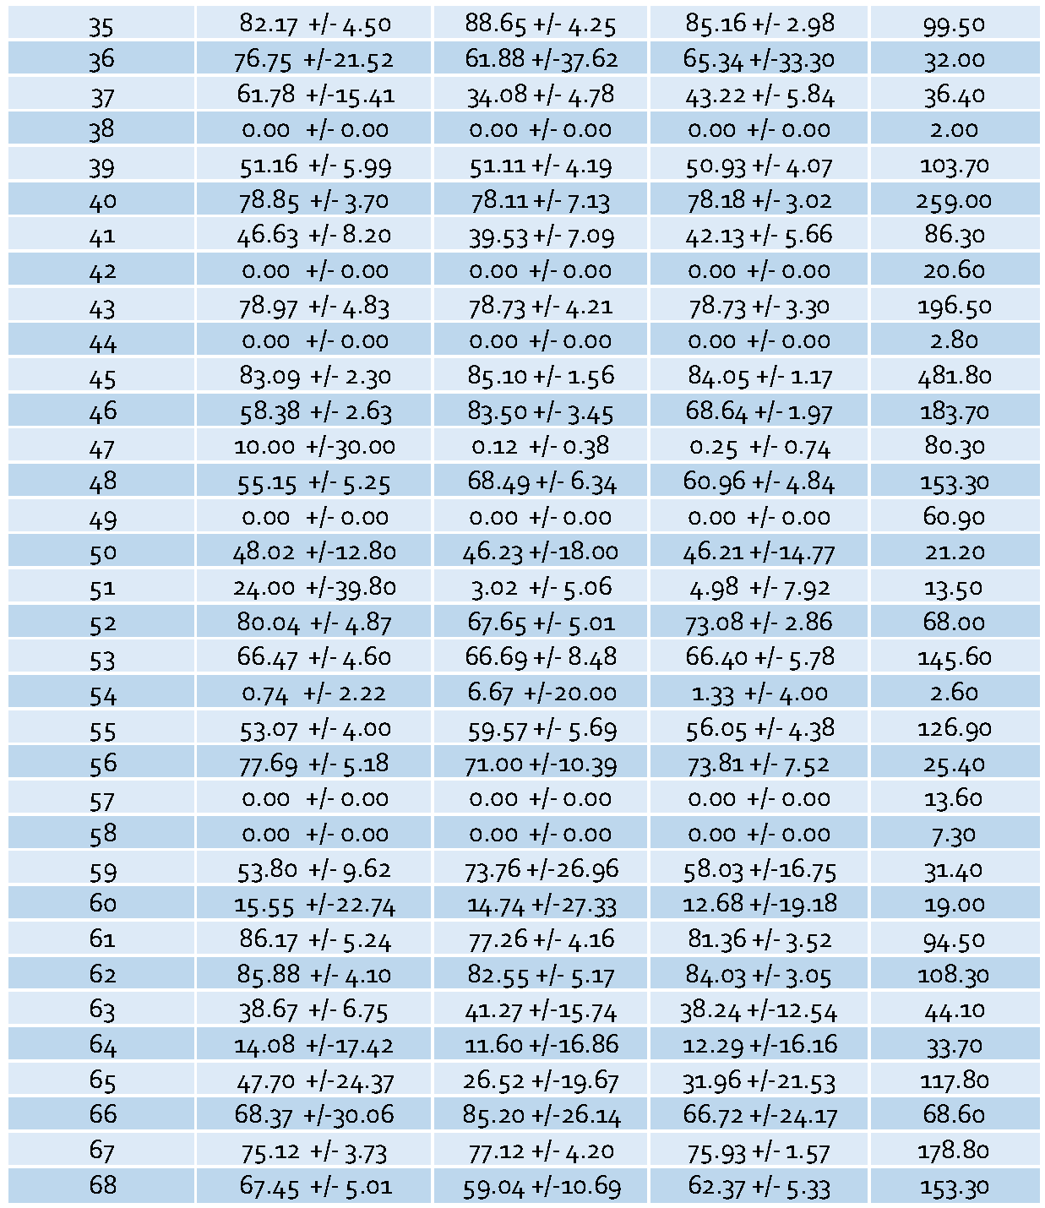
Word Embedding: Convolutional Neural Network Approch
Overall results
Overall results – classes analisys
Indian Parliament Q&A Dataset
A. Caruso, P. Calabrese

Slide 46




Word Embedding: Long Short-Term Memory Approch
An artificial recurrent neural network with multiple hidden layers and feedback connections that can process sequences of data, such as speech or text.
LSTM Layer
Word 1
$$h_{0}$$
Word 2
Final Hidden
State
FC Layer
Classification
$$h_{1}$$
Embedding Layer
Word 3
$$h_{2}$$
….
$$h_{m}$$
Word N
….
….
A. Caruso, P. Calabrese

Slide 47
Word Embedding: Long Short-Term Memory Approch
Model Parameters
 | Range Values | Selected Values
LSTM layer size | 64, 128, 192 | 192
Dense layer size | 30, 50, 100 | 50
activation | tanh, relu | relu
optimizer | sgd, adam | adam
A. Caruso, P. Calabrese

Slide 48
Word Embedding: Long Short-Term Memory - Results
Italian Parliament QT Dataset
A. Caruso, P. Calabrese

Slide 49
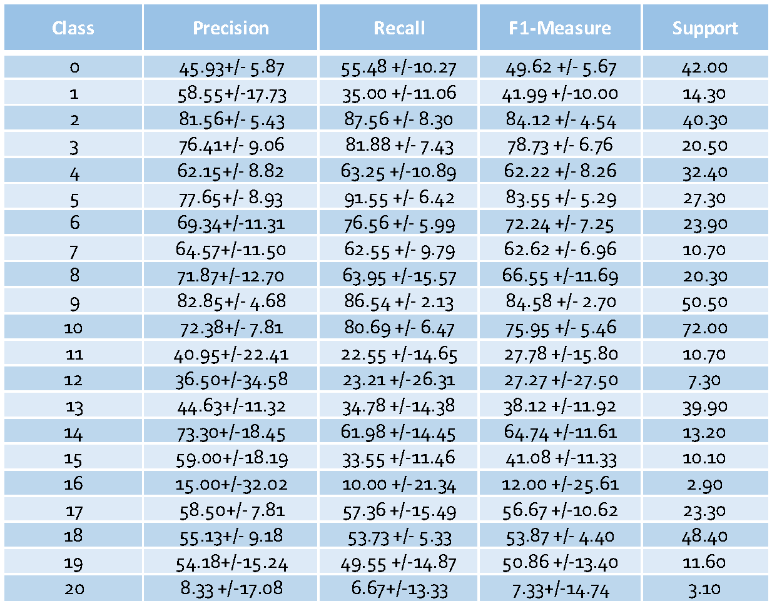
Word Embedding: Long Short-Term Memory Approch
Overall results
Overall results – classes analisys
Italian Parliament QT Dataset
A. Caruso, P. Calabrese

Slide 50
Word Embedding: Long Short-Term Memory - Results
Indian Parliament Q&A Dataset
A. Caruso, P. Calabrese

Slide 51
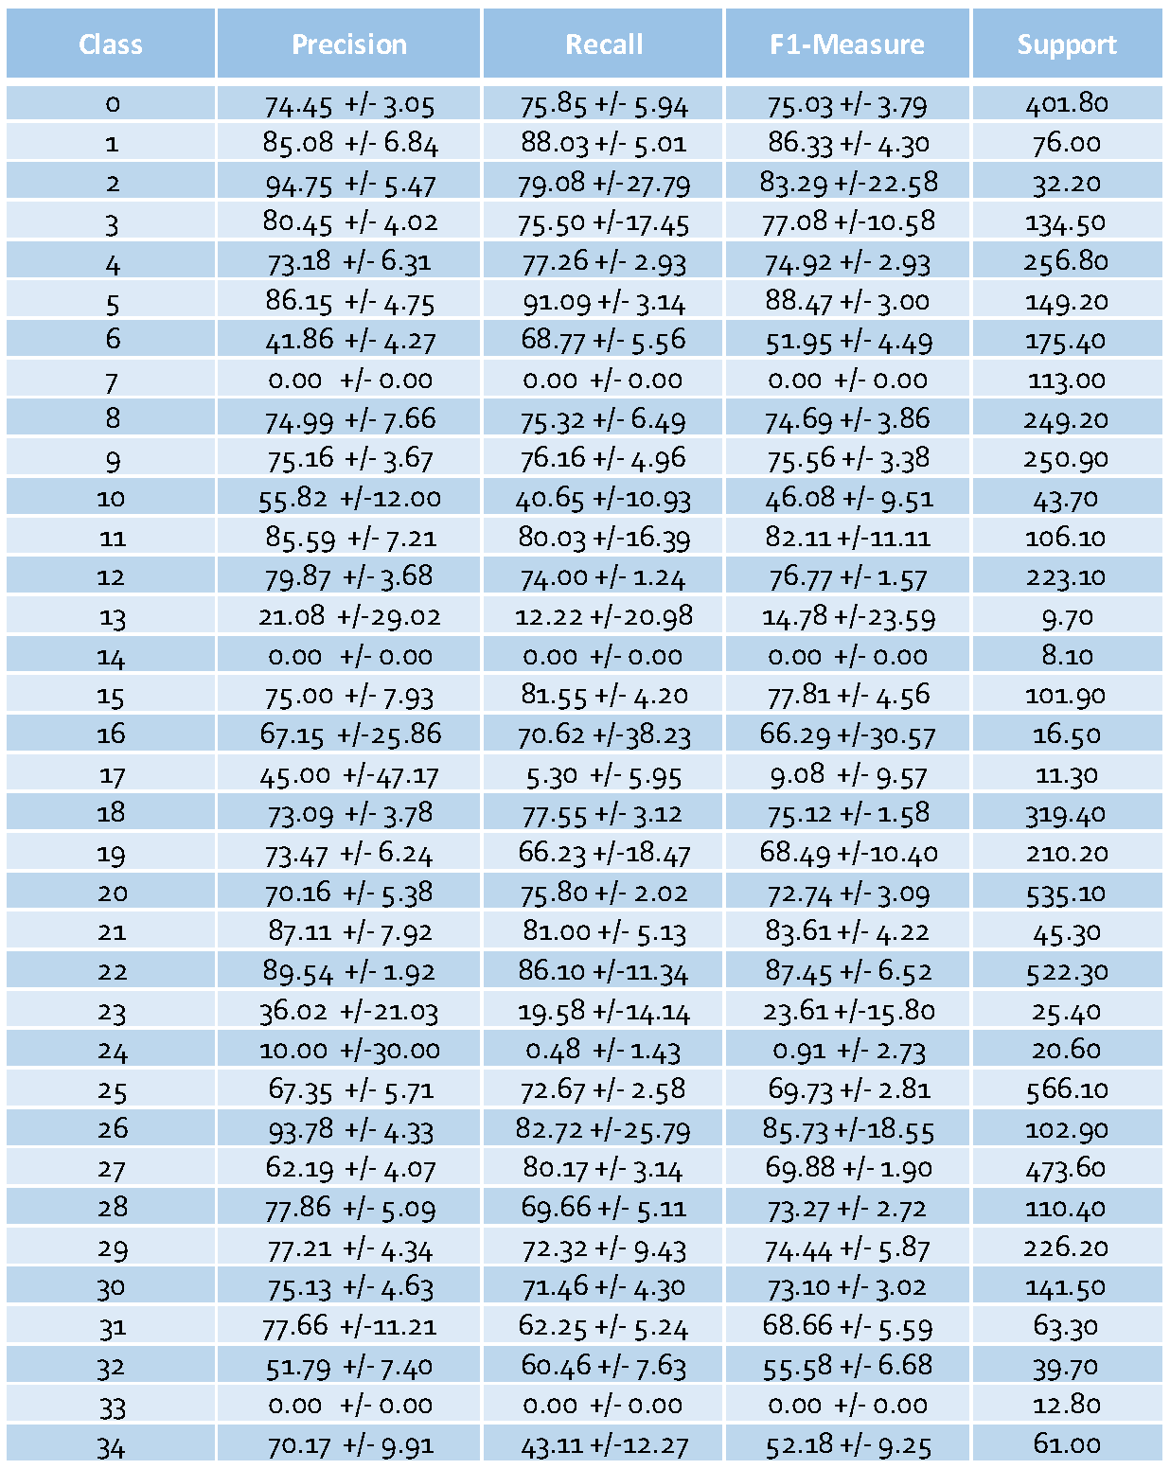
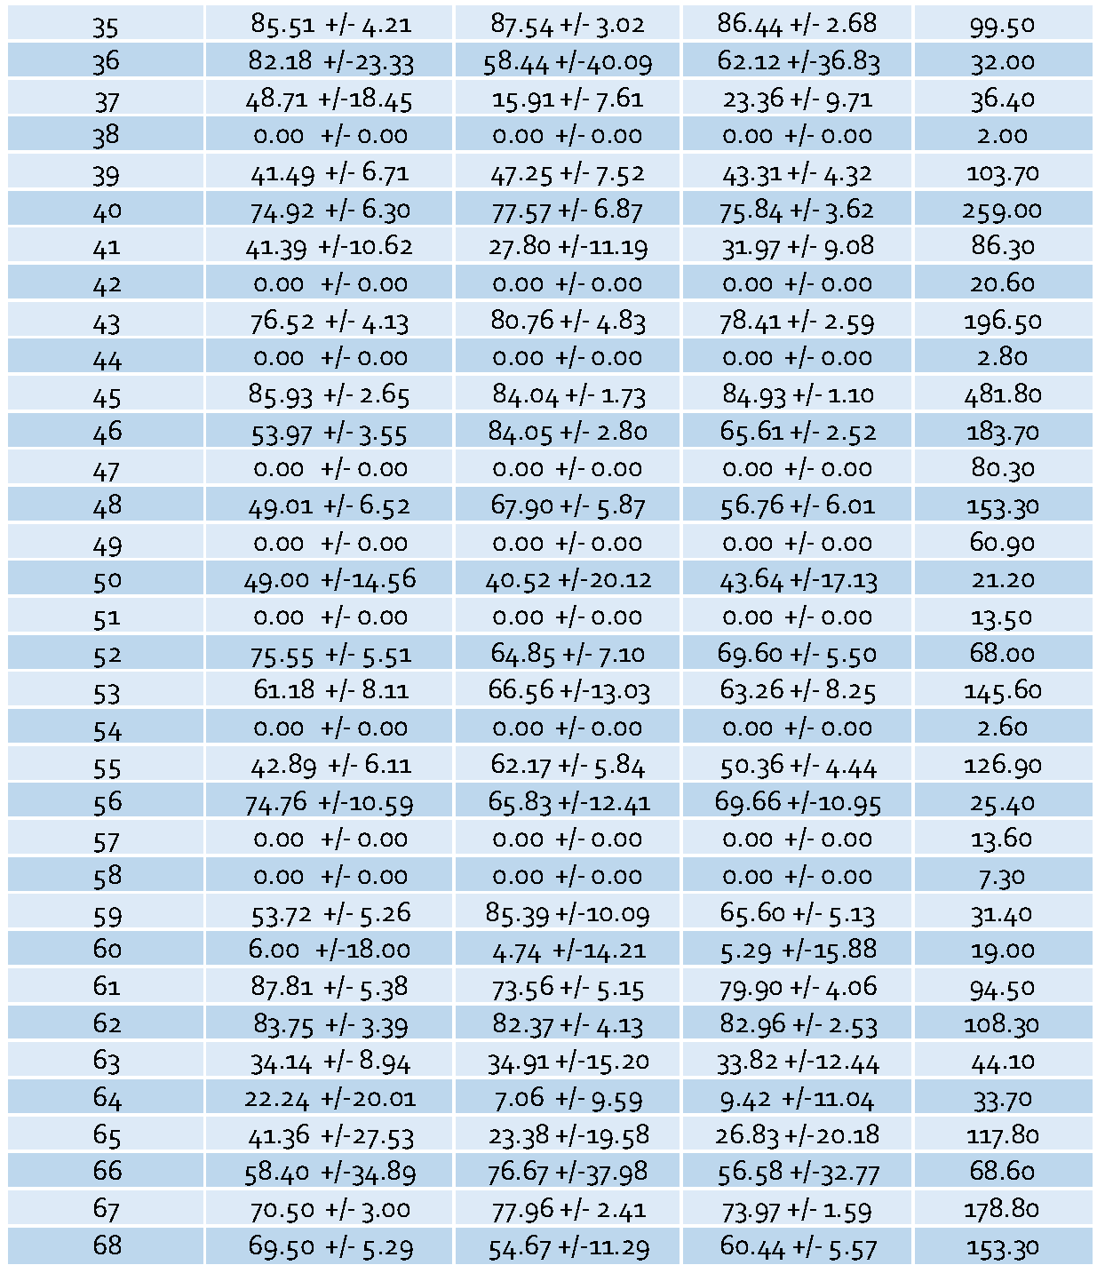
Word Embedding: Long Short-Term Memory Approch
Overall results
Overall results – classes analisys
Indian Parliament Q&A Dataset
A. Caruso, P. Calabrese

Slide 52
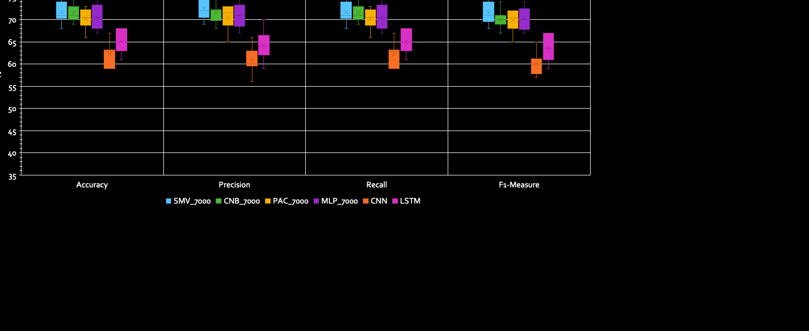
Overall Results Comparison Chart
Italian Parliament QT Dataset
A. Caruso, P. Calabrese

Slide 53
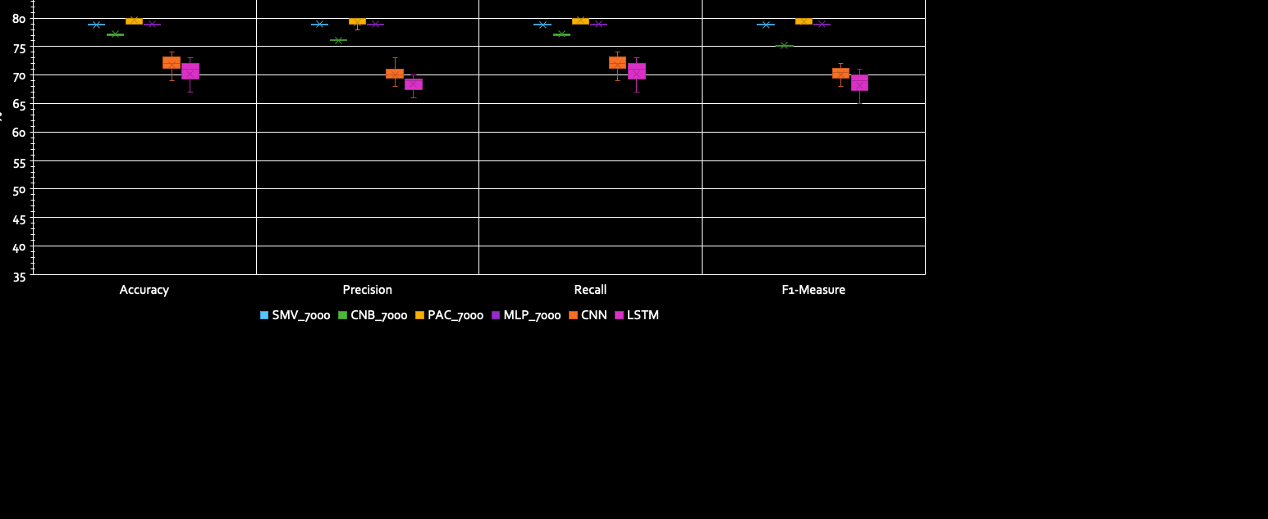
Overall Results Comparison Chart
Indian Parliament Q&A Dataset
A. Caruso, P. Calabrese

Slide 54
Thank You For Your Attention
A. Caruso, P. Calabrese

